Slide 1
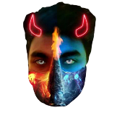
Something
Contents
Profiles
Iftekhar Ahmed Arnab
Iftekhar Ahmed Arnab
18:33 AM
Add Friend
View Profile
Post Content Here Post Content Here Post Content Here Post Content Here Post Content Here Post Content Here Post Content Here Post (Read More)…..
Iftekhar Ahmed Arnab
Add Friend
View Profile
Iftekhar Ahmed Arnab
Add Friend
View Profile
Iftekhar Ahmed Arnab
Add Friend
View Profile

